Slide 1
Front End Engineering-I Project
Team Details:
RAHUL (REPRESENTATIVE)
RAKSHIT
RAGHAV
Faculty Coordinator:
Dr. CHETNA KAUSHAL
:
Chitkara University Institute of Engineering and Technology,
Chitkara University, Punjab

Slide 2
Table of Contents
TOPICS | SLIDE NO.
Introduction
Problem Statement
Technical Details
Key Features
Project Highlights
Additional Feature(EMOJI)
Conclusion
References/Links used

Slide 3
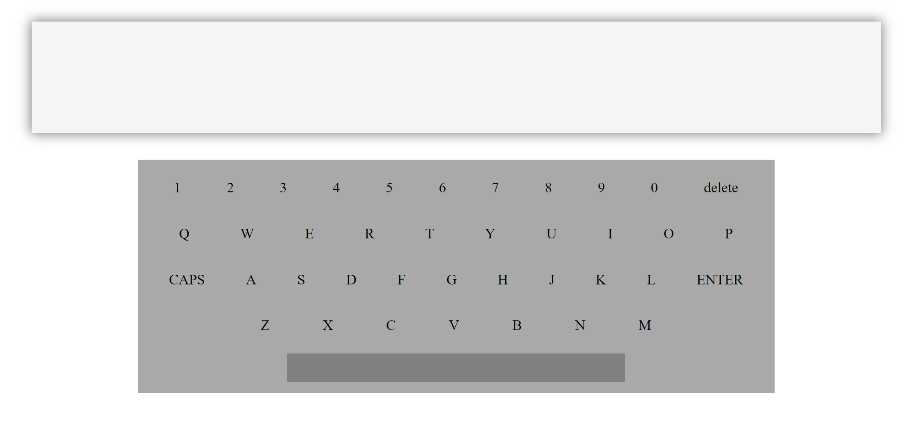
Introduction
VIRTUAL KEYBOARD
A virtual keyboard on the web is a software-based interface that allows users to input text or control their devices using a keyboard displayed on a screen, typically through a web browser.

Slide 4
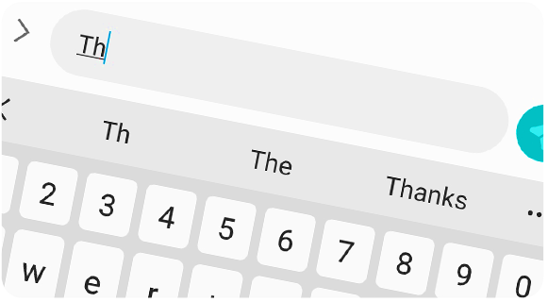
Problem Statement
Enhanced Typing Efficiency and Predictive Text:
Virtual keyboards often include predictive text, autocorrect, and word suggestion features, leading to improved typing efficiency and accuracy, particularly on touchscreen devices. Education and Skill Development:

Slide 5
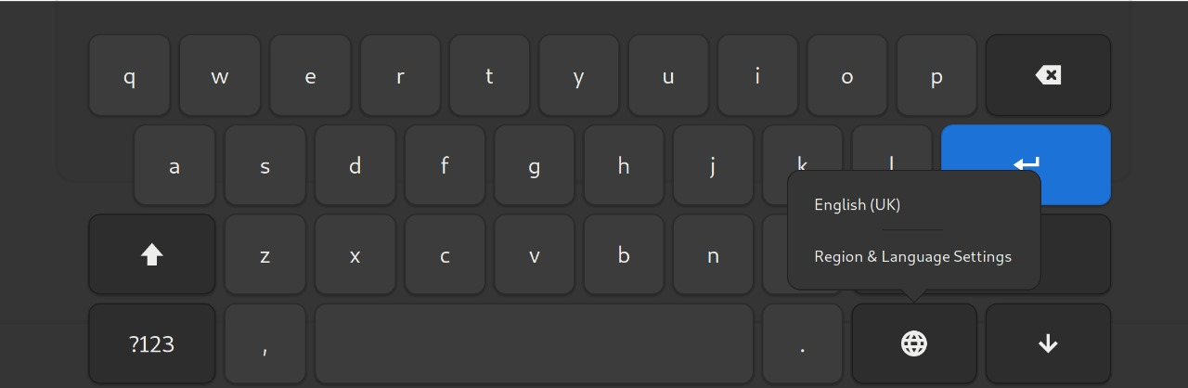
Problem Statement
Multilingual Input Support:
Physical keyboards have limitations in supporting multiple languages and layouts. Virtual keyboards easily switch between languages and keyboard layouts, offering multilingual support and accommodating users from diverse linguistic backgrounds.

Slide 6
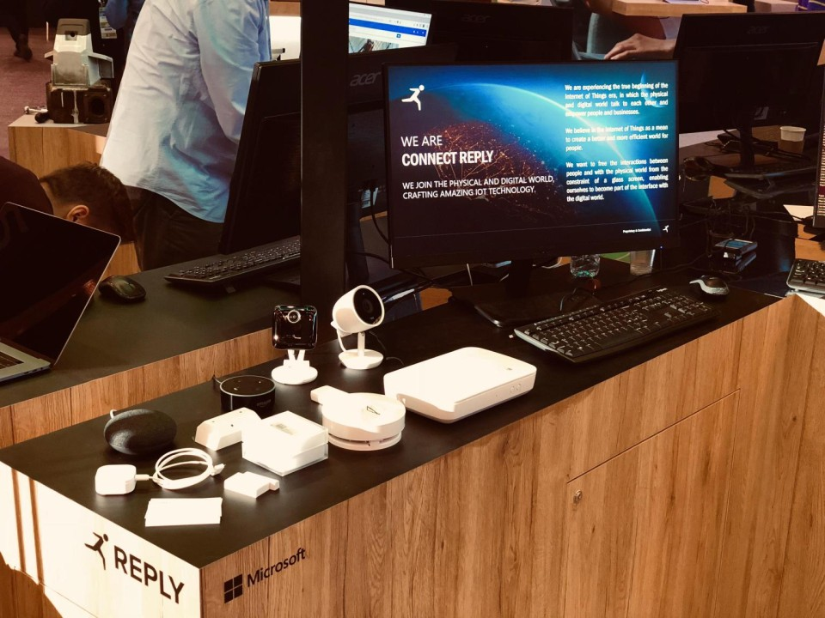
Problem Statement
Space and Portability Constraints:
Physical keyboards are bulky and impractical for many portable devices. Virtual keyboards address this issue by providing a compact and space-saving alternative, especially for smartphones, tablets, and other compact devices.

Slide 7
Technical Details
HTML Structure:
Create the basic HTML structure to represent the keyboard layout, keys, and other elements.
CSS Styling:
Use CSS to style the keyboard layout, keys, and any additional design elements to make it visually appealing.
CSS Grid or Flexbox:
Utilize CSS Grid or Flexbox to layout the keys in a grid-like structure, allowing for easy alignment and arrangement.
Key Styling:
Apply CSS styles to keys, including background colour, border, font size, and padding to make them visually distinguishable and user-friendly. Add CSS transitions or animations to create visual feedback when a key is pressed, enhancing the user experience. By combining HTML for structure, CSS for styling and layout, and JavaScript for interactivity and event handling, you can create an effective virtual keyboard for use on a webpage.

Slide 8
Key Features
Touchscreen Interface: Virtual keyboards are designed to be used on touchscreen devices like smartphones, tablets, or computers with touch displays
Visual Representation of Keys: Virtual keyboards display a visual representation of keys, usually mimicking the layout of a physical keyboard. The keys may be arranged in the QWERTY or other common keyboard layouts.
Numeric Access: Virtual keyboards often include keys for numbers accessible through additional layouts or by pressing specific modifier keys.
Emoji and Emoticon Support: Many virtual keyboards include options to easily input emojis, emoticons, and other special characters used in messaging and communication.

Slide 9
Project Highlights
This slide followed by many slides include the relevant screenshots of the running project and their corresponding code snippets.
It should frame the complete picture of your solution.

Slide 10
Bonus Feature(optional)

Slide 11
Conclusion
Creating a virtual keyboard using HTML and CSS was a Great learning experience. Through this project, we gained a deeper understanding of web development, particularly in designing user interfaces and incorporating interactivity into a webpage.
The project involved structuring the virtual keyboard using HTML, styling it using CSS to ensure a visually appealing layout and responsive design. It was essential to design an intuitive user interface with a layout resembling a standard keyboard, allowing users to input characters and perform actions seamlessly.
Overall, this project not only helped us apply theoretical knowledge but also sharpened our problem-solving skills, teamwork abilities and project management capabilities. It served as a practical demonstration of web development concepts and significantly contributed to my growth as a web developer.

Slide 12
References/Links used
https://developer.mozilla.org/en-US/docs/Web/Html
https://www.Washington.edu
https://en.m.Wikipedia.org
https://evirtuslguru.com

Slide 13


